Slide 1

Centralized configuration made easy with Azure App Configuration
Callon Campbell
Microsoft MVP
@flying_maverick | theflyingmaverick.com

Slide 2

About me
Solution Architect | Developer
Microsoft MVP in Azure
20 years enterprise development with Microsoft technologies – .NET, Azure, Web, Desktop, SQL, and Mobile
Blogging at https://theflyingmaverick.com
Speaker at community events and meetups
Co-creator of ReflectInsight, live .NET log viewer

Slide 3
Agenda
What is Azure App Configuration
Features and scenarios
Demos
Portal and Azure CLI
Implementing and using with ASP.NET Core
DevOps
Wrap-up
Q&A

Slide 4
What is Azure App Configuration?
Azure App Configuration provides a service to centrally manage application settings and feature flags
Notes:
Azure App Configuration helps you manage application settings and control their access centrally.
It also simplifies your deployment tasks and eases the burden of dealing with permutations of configurations created by multiple applications, dependencies, and environments.

Slide 5
Why use Azure App Configuration?
Modern cloud applications are distributed
Multiple instances running in multiple geographic regions
Managing application settings across these distributed instances is hard
Difficulty in troubleshooting issues
Best practice is to separate application settings from application code
Ideal for microservices, containerized apps, serverless apps, and continuous deployment pipelines, but not limited to these apps
Notes:
Built on the simple concept of key-value pairs, this service provides manageability, availability, and ease-of-use.
You can store and retrieve settings for applications, microservices, platforms, and CI/CD pipelines.

Slide 6
Azure App Configuration Features
Fully managed service
Flexible key representation and mappings
Key tagging with labels
Point in time snapshot of settings
Dedicated UI for feature flag management
Comparison of two sets of configurations
Support for Azure-managed identities
Data encryption, at rest or in transit
Native integration with popular frameworks (.NET, Java)

Slide 7
What about Azure Key Vault?
Azure Key Vault is a tool for securely storing and accessing secrets.
A secret is anything that you want to tightly control access to, such as API keys, passwords, or certificates.
A vault is logical group of secrets.
Notes:
https://docs.microsoft.com/en-us/azure/key-vault/basic-concepts
https://azure.microsoft.com/en-us/services/key-vault/

Slide 8
What about Azure Key Vault? (cont.)
Azure App Configuration complements Azure Key Vault
Not a replacement for Azure Key Vault
Azure App Configuration is not the best option for application secrets
Azure Key Vault is best for:
Application secrets
Connection strings
App Configuration is optimized for hierarchical and/or dynamic application settings.
Notes:
App Configuration is complementary to Key Vault, and the two should be used side by side in most application deployments.
They’re typically used side by side to store and distribute application configuration data. While Key Vault is designed for secret management and operations, App Configuration is optimized for hierarchical and/or dynamic application settings.
App Configuration supports:
- Hierarchical namespaces
- Labeling
- Extensive queries
- Batch retrieval
- Specialized management operations
- A feature-management user interface

Slide 9
Keys and Values
Azure App Configuration is made up of key-value pairs
Keys are the names of the key-value pairs
Unicode base, case sensitive
ASP.NET Core configuration is case-insensitive
Use any Unicode character except for * , \
Support for import/exporting
There is a limit of 10KB for a single key-value item

Slide 10
Getting started with Azure App Configuration in the Azure portal and Azure CLI
Demo 1

Slide 11
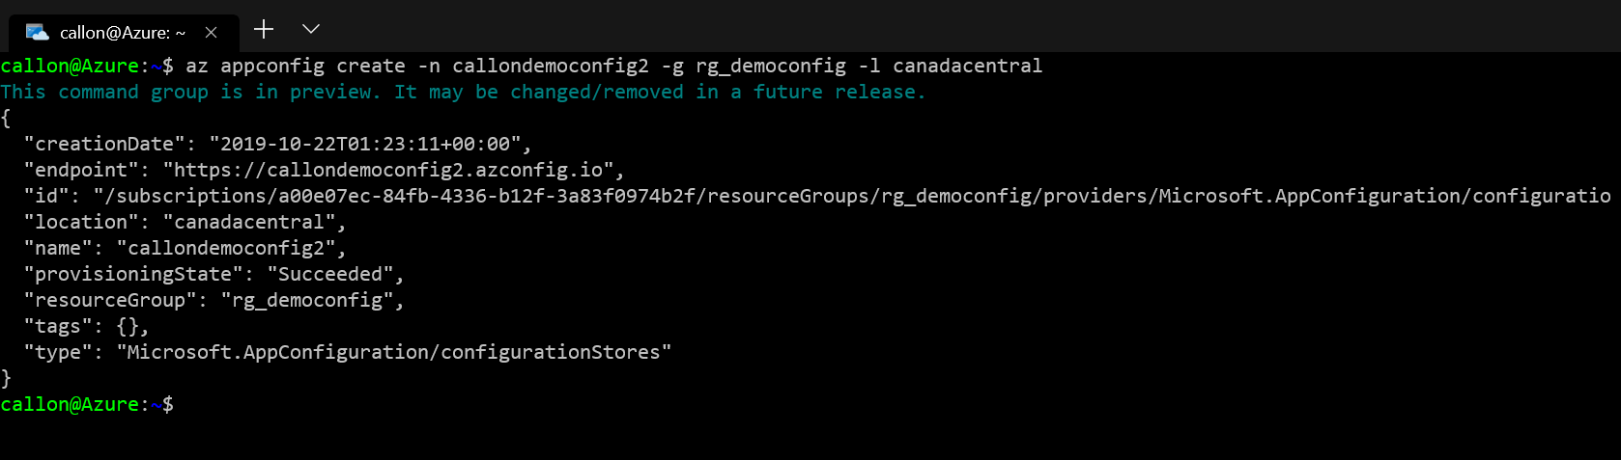
Create Azure App Configuration - Azure CLI

Slide 12
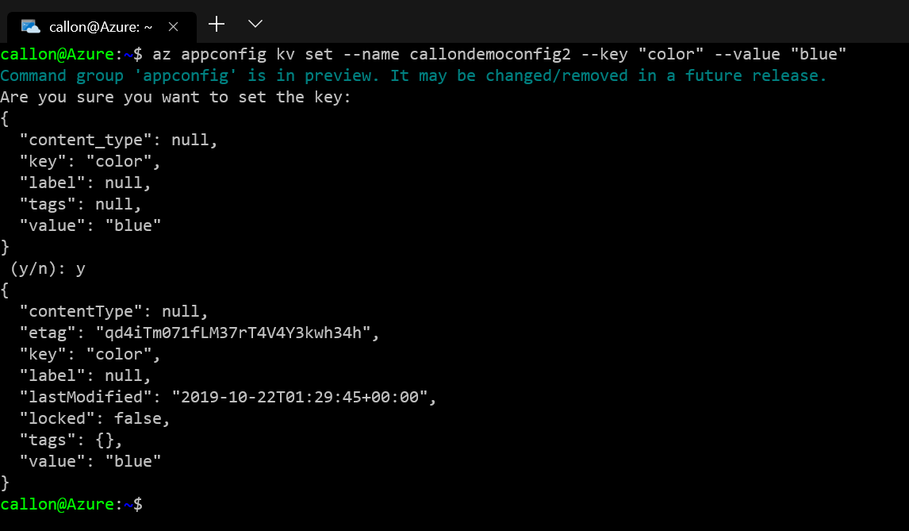
Creating a new key-value - Azure CLI

Slide 13
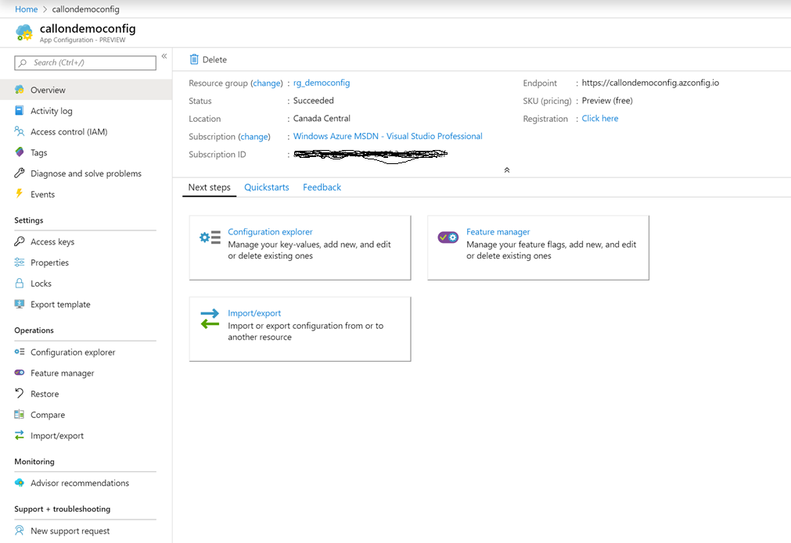
Overview

Slide 14
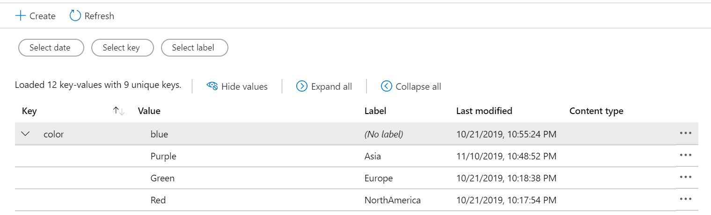
Labels

Slide 15
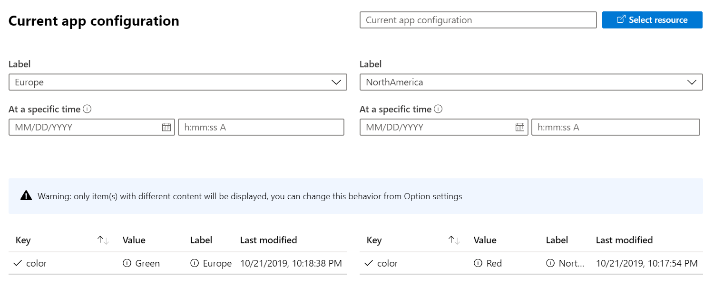
Key Comparison

Slide 16
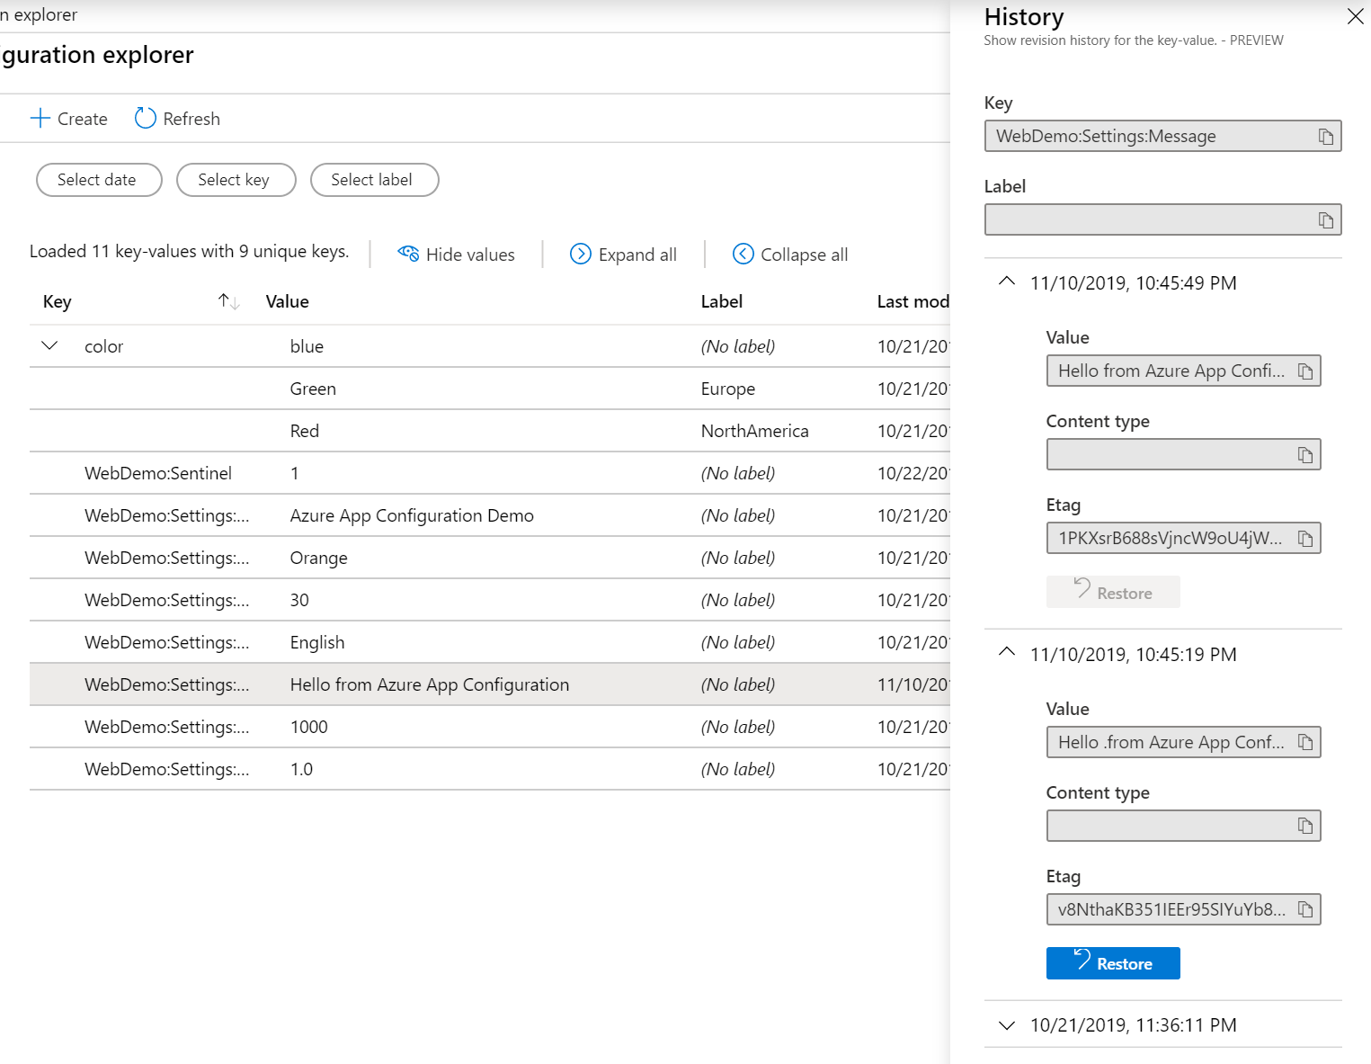
History Log and Restore

Slide 17
Implementing Azure App Configuration with ASP.NET Core
Demo 2

Slide 18
Nugets
ASP.NET Core
Install-Package Microsoft.Azure.AppConfiguration.AspNetCore -Version 2.0.0-preview-010060003-1250
.NET Core / .NET Framework
Install-Package Microsoft.Extensions.Configuration.AzureAppConfiguration -Version 2.0.0-preview-010050001-38

Slide 19
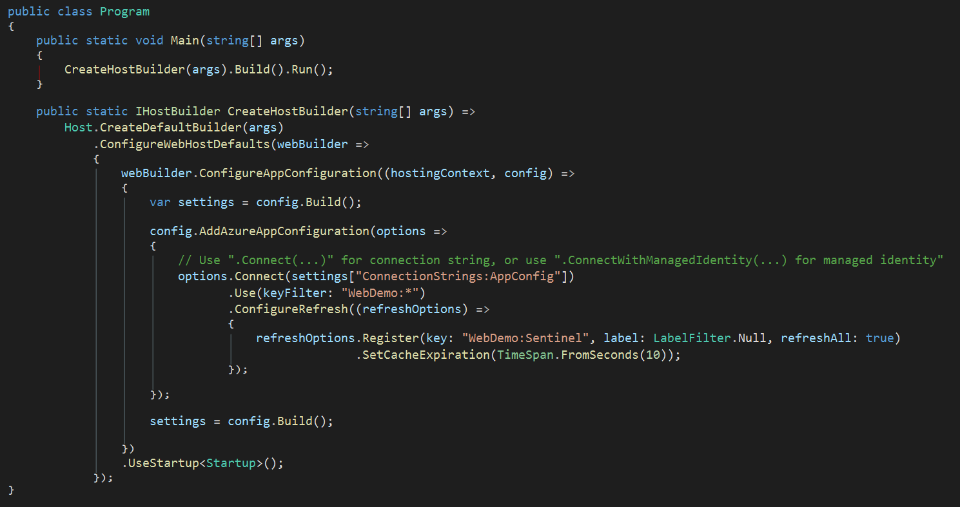
Program.cs

Slide 20
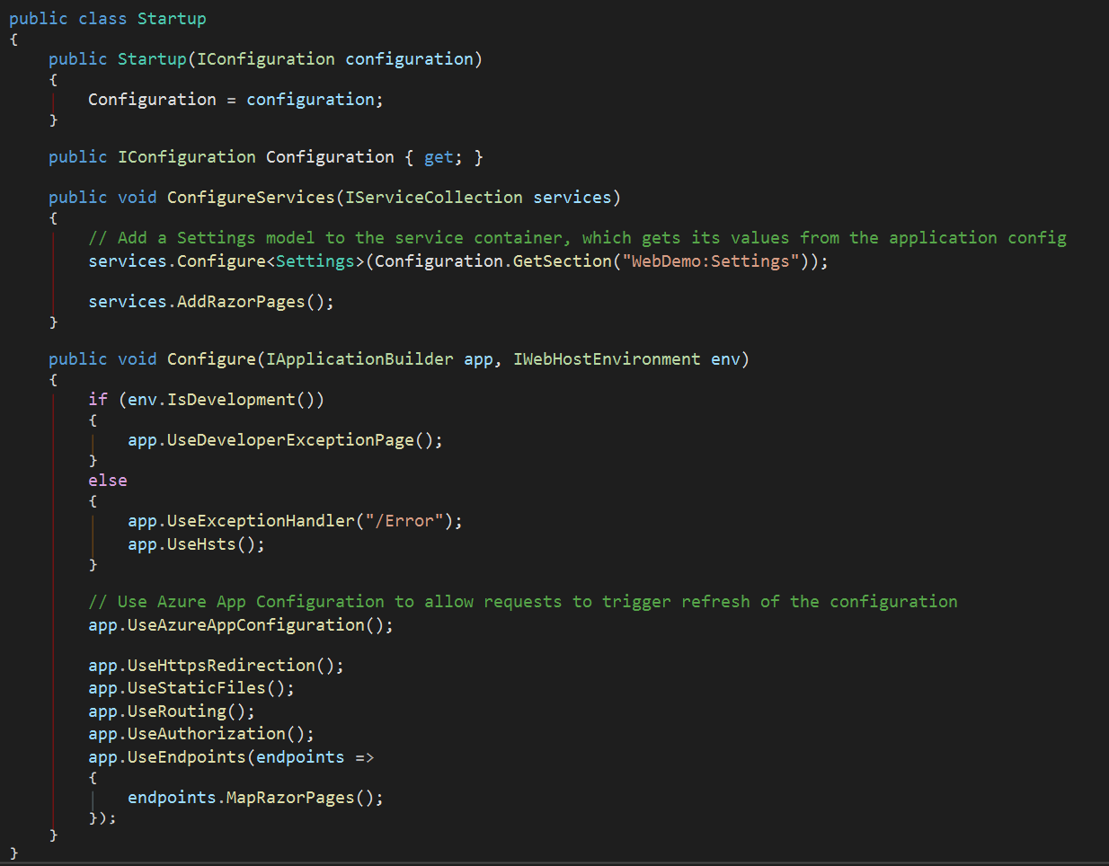
Startup.cs

Slide 21
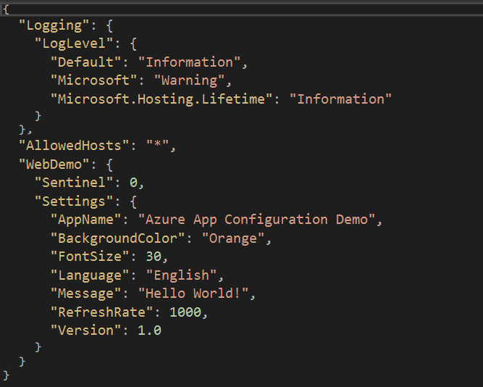
Appsettings.json

Slide 22
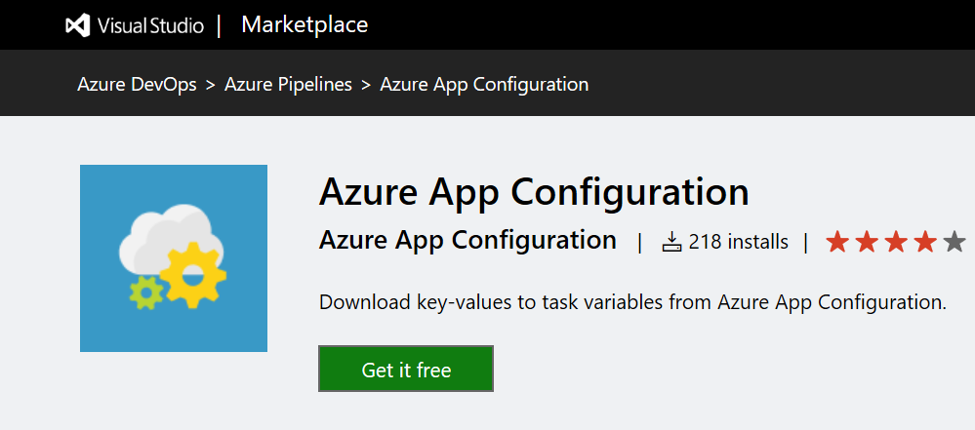
Azure App Configuration in CI/CD
https://marketplace.visualstudio.com/items?itemName=AzureAppConfiguration.azure-app-configuration-task

Slide 23
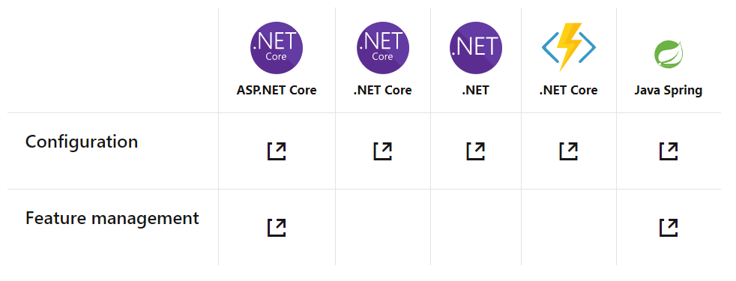
Supported Platforms:
Notes:
ASP.NET Core and .NET Core – App Configuration provider for .NET Core
ASP.NET and .NET – App Configuration builder for .NET
Java Spring – App Configuration client for Spring Cloud
Others – App Configuration REST API

Slide 24
Wrap up
Free during preview (GA approx. end of 2019)
Azure App Configuration is available in preview in the Canada Central, East US, Central US, West Central US, West US, West Europe, and Southeast Asia regions
Public REST API (VNET support is coming…)
Feature Management is limited to ASP.NET Core and Java Spring framework applications

Slide 25

Thank you!
CallonCampbell@Outlook.com
TheFlyingMaverick.com
@Flying_Maverick

Slide 26
References
Information on Azure App Configuration
Azure App Configuration docs
Quickstart: Create an ASP.NET Core app with Azure App Configuration
Azure App Configuration REST API Reference (GitHub)
Azure App Configuration for Azure DevOps

